Slide 1
Course resources
Check university email
Online forum – Piazza
Online meeting – Tencent meeting

Slide 2
Descriptive statistics
Kaidi Wang
kdwang@must.edu.mo
Office: O913
Office hour: 14:00 – 15:00 on Mon., Tue., Wed., Thu.

Slide 3
Analyzing distributions
Percentiles: A percentile is the value of a variable at which a specified (approximate) percentage of observations are below that value. The pth percentile tells us the point in the data where approximately p% of the observations have values less than the pth percentile. Calculation? Imputation using Python?
Quartiles:
Q1=1st quartile, or 25th percentile
Q2=2nd quartile, or 50th percentile (also the median)
Q3=3rd quartile, or 75th percentile
Example:
20, 35, 24, 40, 19, 30, 46, 33, 50, 73, 64, 80

Slide 4

z-Scores
A z-score allows us to measure the relative location of a value in the data set.
More specifically, a z-score helps us determine how far a particular value is from the mean relative to the data set’s standard deviation.
The z-score for $x_{i}$ is:
$$z_{i}= \frac{x_{i}−\overline{x}}{s}$$
Where $\overline{x}$ is the sample mean, s is the sample standard deviation. z-score is often called the standardized value.

Slide 5
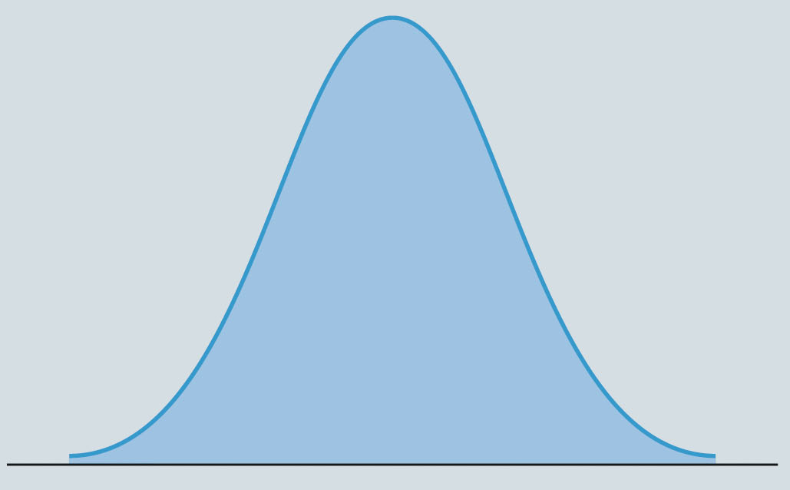
Empirical rule
When the distribution of data exhibits a symmetric bell-shaped distribution, the empirical rule can be used to determine the percentage of data values that are within a specified number of standard deviations of the mean.
For data having a bell-shaped distribution:
Approximately 68% of the data values will be within 1 standard deviation of the mean.
Approximately 95% of the data values will be within 2 standard deviations of the mean.
Almost all of the data values will be within 3 standard deviations of the mean.

Slide 6
Outliers
Sometimes a data set will have one or more observations with unusually large or unusually small values. These extreme values are called outliers.
Types of outliers: incorrect record (to correct), record outside the population (to remove), unusual data (to keep).
Identification:
Recall that almost all the data are within 3 standard deviation of the mean.
Outliers are data points with z-score larger than 3 or smaller than -3.

Slide 7
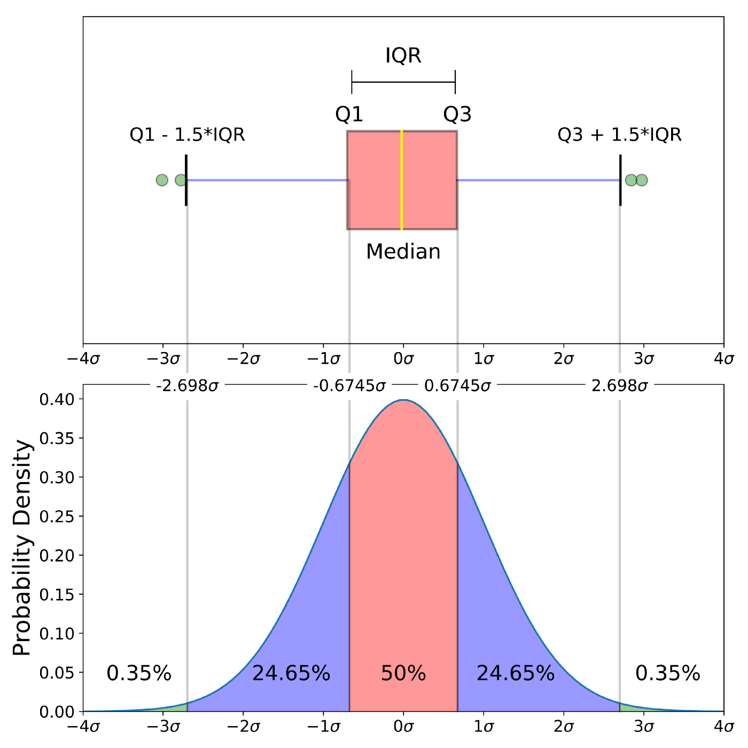
Boxplot
How to plot boxplot in Python?

Slide 8
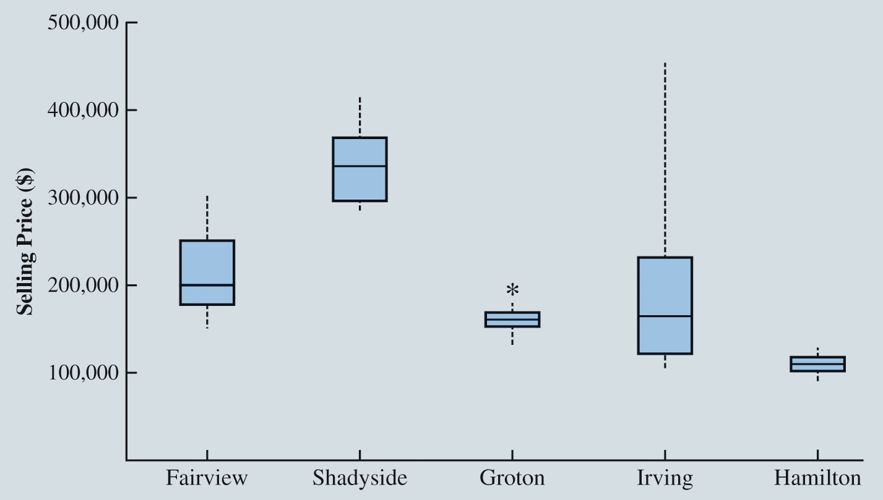
Boxplot - example
Boxplots Comparing Home Sale Prices in Different Communities
How to plot boxplot for multiple columns?

Slide 9
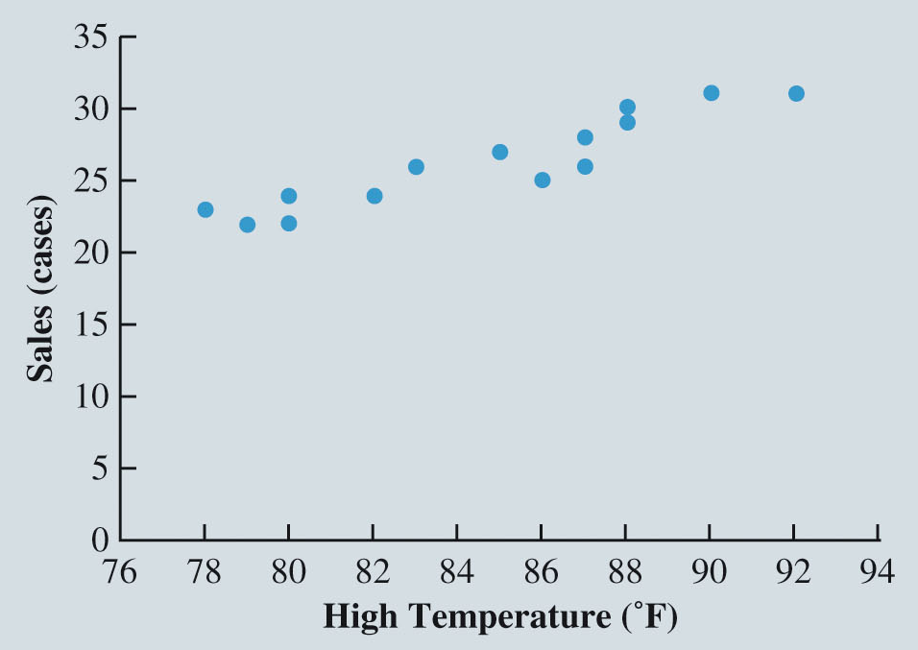
Measures of association between two variables
Data for Bottled Water Sales at Queensland Amusement Park for a Sample of 14 Summer Days
High Temperature (°F) | Bottled Water Sales (cases)
78 | 23
79 | 22
80 | 24
80 | 22
82 | 24
83 | 26
85 | 27
86 | 25
87 | 28
87 | 26
88 | 29
88 | 30
90 | 31
92 | 31

Slide 10
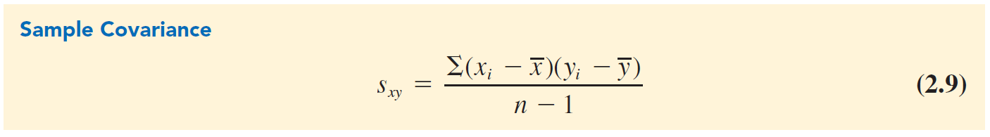
Covariance
Covariance is a descriptive measure of the linear association between two variables.
For a sample of size n with the observations (x1,y1), (x2,y2) , and so on, the sample covariance is defined as

Slide 11
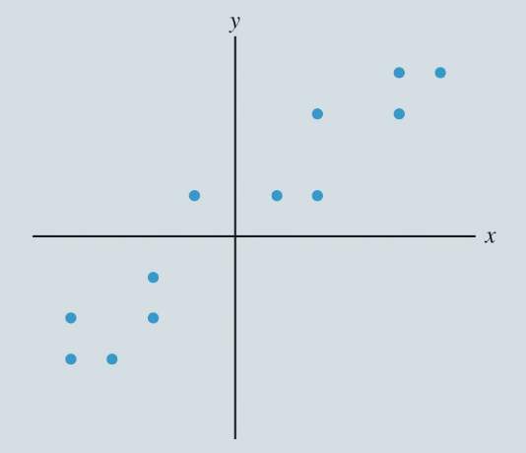

Covariance and scatter plot
Scatter plot and Covariance Values for Different Variable Relationships

Slide 12
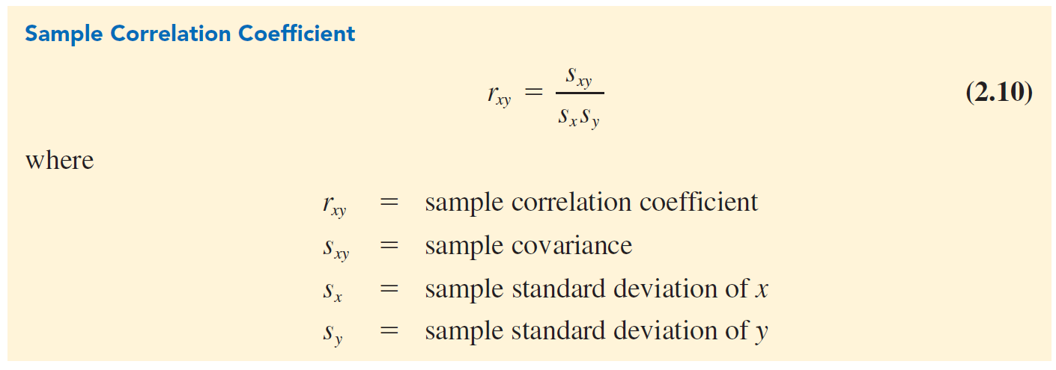
Correlation Coefficient
The correlation coefficient measures the relationship between two variables. It is not affected by the units of measurement for x and y.
r is between -1 and +1. It can only measure the linear relationship.

Slide 13
Data Cleansing
Missing data
Blakely Tires
Identification of Erroneous Outliers and other Erroneous Values
Variable Representation

Slide 14
Missing data
Missing Data:
Data sets commonly include observations with missing values for one or more variables.
In some cases, missing data naturally occur; these are called legitimately missing data.
Generally, no remedial action is taken for legitimately missing data.
In other cases, missing data occur for different reasons; these are called illegitimately missing data.
The primary options for addressing such missing data are:
To discard observations (rows) with any missing values.
To discard any variable (column) with missing values.
To fill in missing entries with estimated values.
To apply a data-mining algorithm that can handle missing values.

Slide 15
Reasons and impacts of missing data
Missing completely at random (MCAR): whether the data are missing does not depend on any variable.
The missing values can be ignored
Missing at random (MAR): whether the data are missing is related to the value of some other variables in the data.
If only a relatively small number of observations are missing values, the missing values can be ignored
Missing not at random (MNAR): whether the data are missing depends on the value that is missing.
The missing values cannot be ignored.

Slide 16
Steps to deal with missing values
Try to determine the actual value.
Impute missing values (replacing missing values with reasonable values)
MCAR
Mean
Median
Mode
MAR
Build model to predict missing values

Slide 17
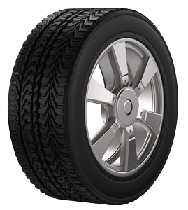
Blakely Tires
To learn about the conditions of its tires, the company collects data from 116 automobiles with Blakely Tires.
Position, i.e., left front, right rear, etc.
Age of the tire
Mileage on the tire
Depth of the remaining tread measured in 32nds of an inch.
Blakely tires have a tread depth of 10/32nds of an inch.
Blakely’s tires generally last for four to five years or 40,000 to 60,000 miles.

Slide 18
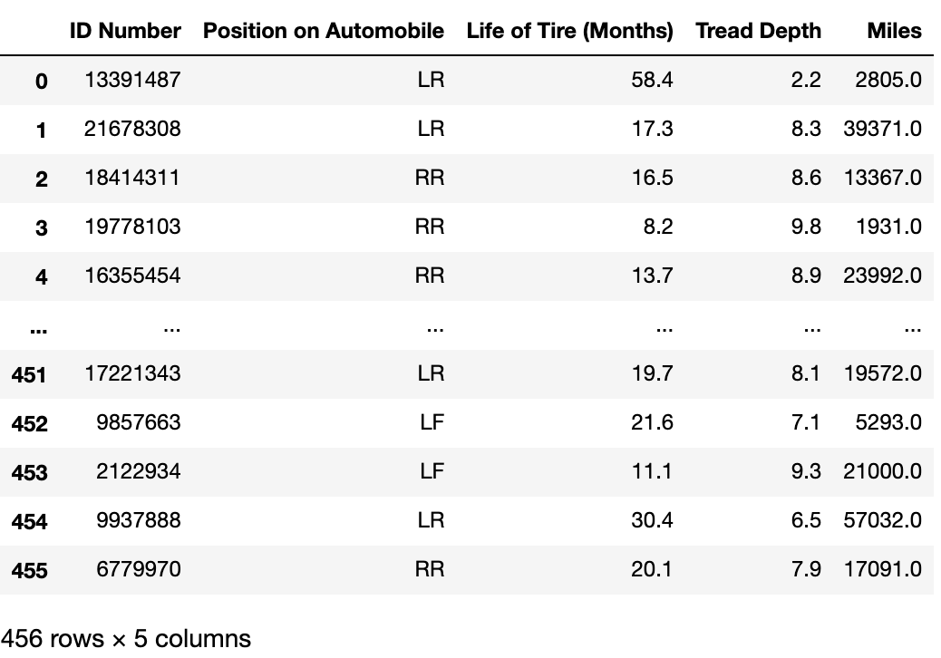
The tire data

Slide 19
Identify Outliers
Summary statistics
Frequency distribution
Bar charts
Histogram
Z-score
Scatter plot
Correlation coefficient
99999 or other special numbers may be used for missing values.

Slide 20
Dimension reduction
Including too many variables in data mining can lead to some issues such as challenging the computation power and sparse datasets.
Therefore, we many need to perform dimension reduction.
Dimension reduction is to transform data from a high-dimensional space to a low-dimensional space.
Feature selection: selecting a subset of the variables for analysis
Feature projection: transform existing variables to fewer variables via projection (i.e., imputation and representation).

Slide 21
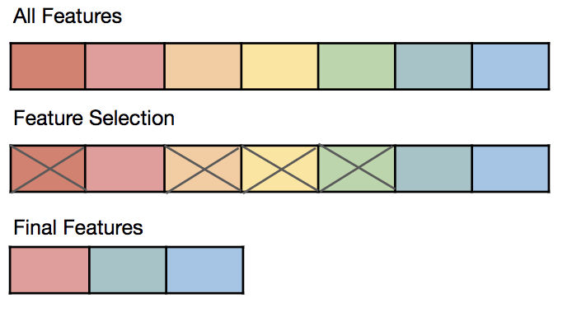
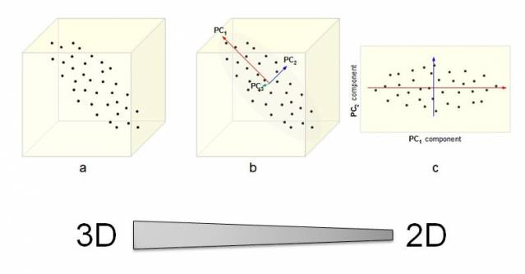
Feature selection and projection

Slide 22
Feature encoding and representation
Encoding:
Categorical variables: dummy or one-hot encoding
Float variables: use raw data or convert to categories
Binary variables: dummy
Feature creation:
Create new features based on the values of other variables, e.g., proportion of household spending on groceries.

